Slide 1
ISTANBUL TECHNICAL UNIVERSITY
BLG 517E - MODELLING AND PERFORMANCE ANALYSIS OF NETWORKS
INSTRUCTOR: SEMA FATMA OKTUĞ
STUDENT NAME: TUĞRUL YATAĞAN
STUDENT NUMBER: 504161551
PAPER PRESENTATION
MAY 12, 2017
Performance study of block ACK and reverse direction in IEEE 802.11n using a Markov chain model
Md Akbar Hossain , Nurul I. Sarkar, Jairo Gutierrez, William Liu
School of Engineering, Computer and Mathematical Sciences, Auckland University of Technology, Auckland 1010, New Zealand

Slide 2
Introduction
The 802.11n standard (2009) introduced several key features:
Block acknowledgement (BA)
Reverse direction protocol. (RD)
In this paper, researchers studied:
Interdependencies of BA and RD mechanisms using a Markov chain model under non-saturated traffic loads.
A mathematical model to derive throughput, delay, and packet loss probability.
Analytical model to track and trace the performance fluctuation issues of 802.11n networks.

Slide 3
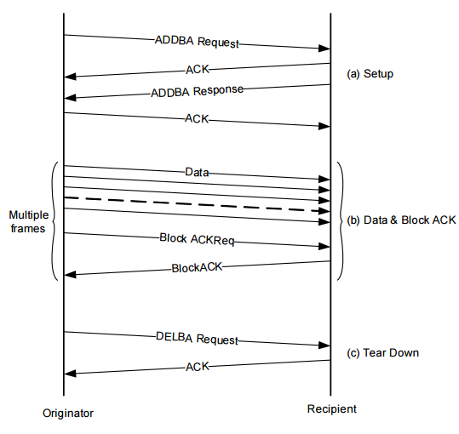
Preliminaries - Block Acknowledgement
A new ACK mechanism in the 802.11e standard (2005).
Unlike the traditional ACK mechanism, an ACK is transmitted to reply to multiple data frames rather than per frame.
The basic idea is aggregate several ACK frames into a single frame to enhance wifi throughput and channel utilization.
Originator and the recipient exchange Add Block Acknowledgement Request/Response frames.
When the frame consists of only one data frame it suffers from severe throughput degradation.
Due to additional frames (BA request and BA).

Slide 4
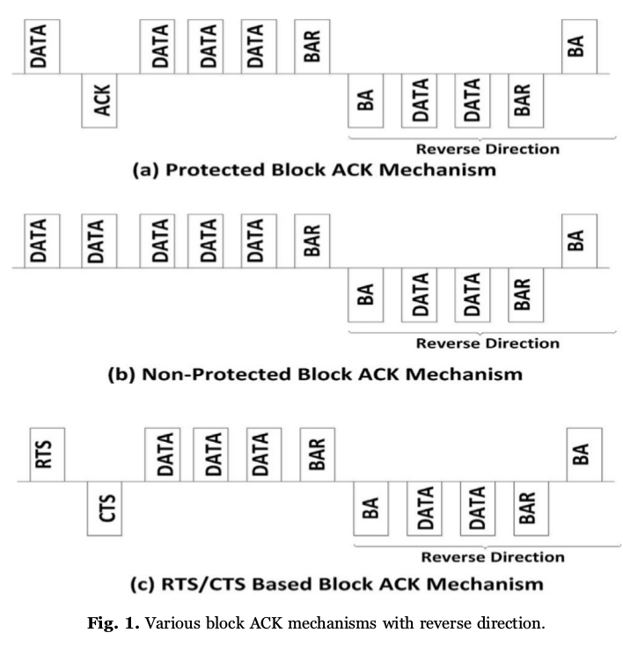
Preliminaries - Block Acknowledgement
Two BA subclasses:
Protected Block ACK; before transmitting an entire data burst the originator will transmit a single data frame.
Unprotected Block ACK; burst entire data.
Wastes transmission opportunity (TXOP) especially in collisions.

Slide 5
Preliminaries - Reverse direction
Until now, when the sender STA is allocated with a TXOP, it informs surrounding STAs about how long the wireless medium will be engaged.
In 802.11n RD, receiver may request a reverse data transmission.
This allows the transportation of data frames and also aggregates frames;
in both directions.
in one Transmission Opportunity (TXOP) period.
RD achieves better results by supporting “on-demand” bi-directional data flows.

Slide 6
Markov model
An analytical model is proposed to evaluate the performance of 802.11n under non-saturated load conditions by taking into account protected Block ACKs and Reverse Direction.
A two dimensional Markov model is developed to derive;
Channel throughput.
End-to-end delay of successful data transmissions.
Assumptions;
Finite number of stations.
Unsaturated load i.e. there is a certain probability that the transmission queue is empty.
Channel is prone to errors.
No hidden terminals.
Packets are destroyed only through collisions exceeding the retry limit.
Packets are of equal length.

Slide 7
Backoff mechanism
For a STA to transmit, it senses the medium to determine if another STA is in transmission.
Transmitting STA must ensure that the medium is idle for a period before attempting to transmit.
STA selects a random backoff interval and decrements the backoff interval counter while the medium is idle.
The timer value must be within the Contention Window values.
A transmission is successful if an acknowledgement (ACK) frame is received.
STA will increase its contention window size after each failed transmission until it reaches the maximum backoff stage.

Slide 8
Backoff mechanism - Abbreviations
n is the number of stations (STAs) in a WLAN.
CW_{i} stands for the contention window size.
τ is the transmission probability of a station in a randomly chosen slot time.
p_{f} denote the frame failure transition probability from one stage to another. (row i−1 to row i)
k = b(t) backoff counter at time t.
Decremented at the start of every idle slot and a contending station wins the channel when it reaches to zero.
Chosen to be uniformly distributed over k ∈ [0, CWi]
After successful transmissions, if the STA has more data to send new value would be set
i = s(t) backoff stages at time t.
Starts at 0 and is increased by 1 everytime transmissions collide.
Once the CW reaches CWm, it will remain at this value until it is reset.
m′ is a maximum number by which the contention window can be doubled.

Slide 9
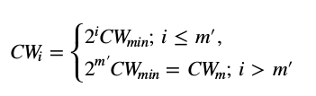
Backoff mechanism - Collision
Collision; there is a chance that two STAs end up with the same b(t) values and transmit data simultaneously.
In order to avoid further collisions, the collided STAs will generate new b(t) values determined by:
Once the CW reaches CW_{m}, it will remain at this value until it is reset. That means STA will keep transmitting the packet till it reaches the retry limit.
If the transmission is still unsuccessful the packet will be dropped.

Slide 10
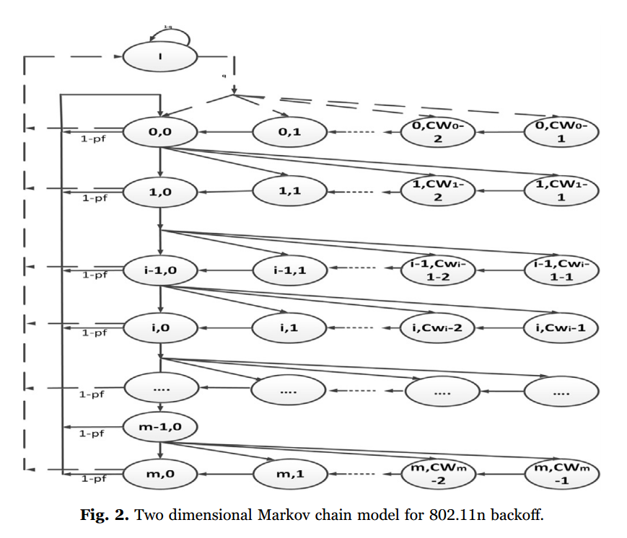

Markov Chain
(s(t), b(t)) will denote the state of this Markov chain.
i = s(t) backoff stages at time t.
k = b(t) backoff counter at time t.
The probability of the station to be in state (i, 0) can be expressed as a n stage transition probability as follows:

Slide 11




Transmission Fail Probability
Unsuccessful transmission attempt can happen due to the collision of a station with at least one of the n−1 remaining stations, occurring with probability:
And by having a frame with errors (fading, noise). FER (frame error probability)
Since both events are independent, the probability of unsuccessful transmission:

Slide 12
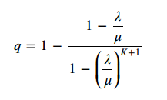
Transmission Queue
The unsaturated traffic behavior is characterized by defining a MAC queue.
Packet arrival rate at each STA buffer from upper layer is λ pkt/s.
μ represent the packet processing rate assuming that the queue has a length of K.
By using a M/M/1/K queueing model, the probability that there is at least one packet to be transmitted in the STA queue;

Slide 13
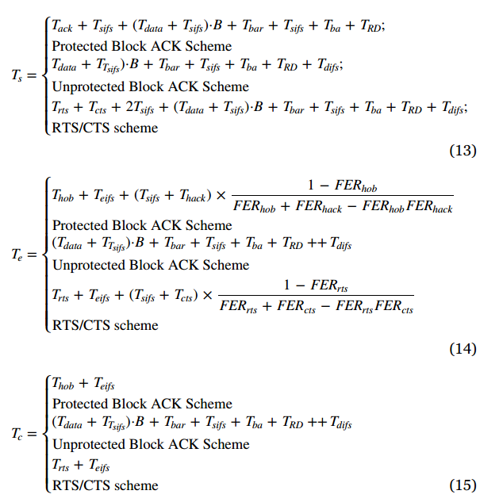
Throughput analysis
Ts is the average time that the channel is captured with successful transmission.
Tc is the average time that the channel is captured by stations which collide.
Te is the average wasted time due to a channel access failure caused by channel error.
Transmission times (measured in microseconds) of an MPDU, an ACK frame, a RTS frame, a CTS frame, a BlockAckReq frame, a BlockAck, a Head of Brust and a Head of ACK frame.

Slide 14
Packet drop probability
A packet can be dropped;
a packet is dropped when the retry limit is reached,
a packet may be dropped when the sending queue is full.
Total packet drop probability is the sum of both of these events.

Slide 15

Packet drop due to retry limit
A packet is found in the last backoff stage m if it encounters m collisions in the previous stages and it is eventually discarded.
Packet drop probability due to reaching the retry limit;

Slide 16
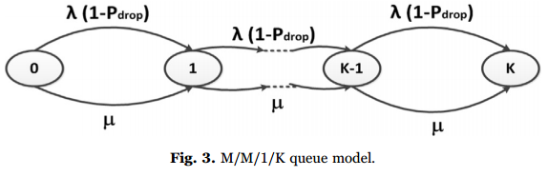
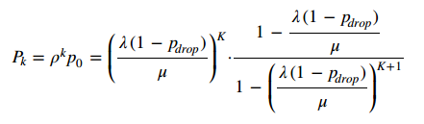
Packet drop due to queue
Consider the M/M/1/K queue system, where there are K frames in the system;
The frames are dropped with probability;

Slide 17
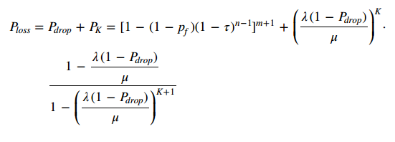
Packet drop probability final
The total probability of packet loss is;

Slide 18

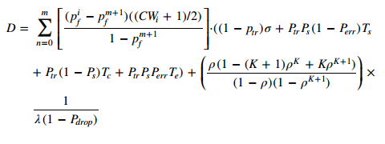
Mean delay
Delay D can be defined as the time elapsing;
from the frame is inserted in the MAC buffer,
to is successfully transmitted.
Delay is associated with two factors:
medium access delay due to the number of contending stations,
queueing delay.
So, average delay is;

Slide 19
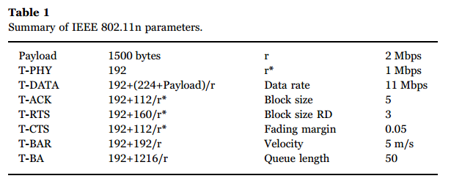
Numerical studies
Paper studied the characteristics of various IEEE 802.11n Block ACK methods.
Analytical model is validated MATLAB based numerical study.
Parameters used in the numerical study;

Slide 20
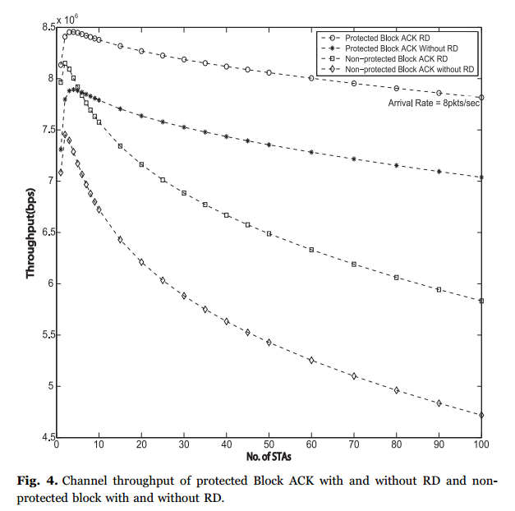
Numerical studies
Packet arrival rate of 8 pkts/s.
Increments of network size significantly reduce the throughput due to collisions.
Protected Block ACK RD provides 32.54% higher throughput than Block ACK with RD.

Slide 21
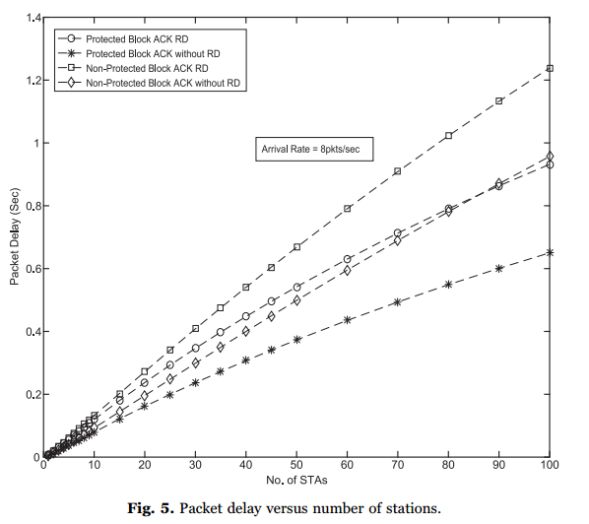
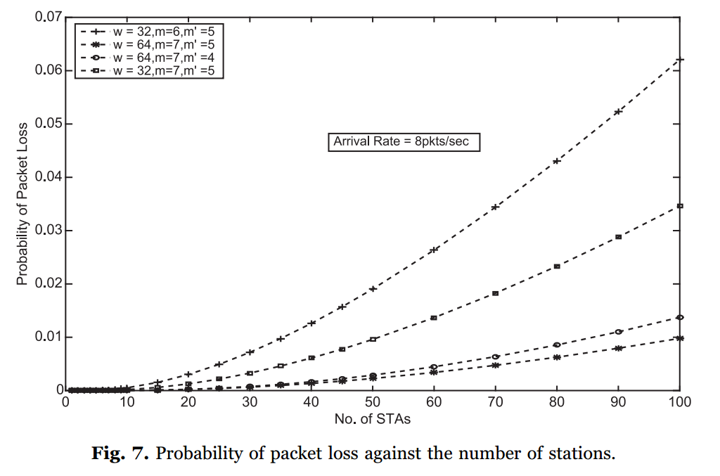
Numerical studies

Slide 22
Conclusion
Paper investigated the interdependencies of Block ACK and RD mechanisms for 802.11n using a discrete bi-directional Markov chain model under non-saturated traffic loads.
Results obtained have shown that the better system performance (i.e. up to 33% higher throughput and 48% less packet dropping) can be achieved using protected Block ACK in conjunction with RD data transmission.
‘unprotected Block ACK’ wastes TXOP especially during collisions and degrades system performance significantly.
To fully utilize the system performance, 802.11n stations should employ protected Block ACK mechanism with RD flows.

Slide 23
Thank you for listening!
Performance study of block ACK and reverse direction in IEEE 802.11n using a Markov chain model
Md Akbar Hossain , Nurul I. Sarkar, Jairo Gutierrez, William Liu
School of Engineering, Computer and Mathematical Sciences, Auckland University of Technology, Auckland 1010, New Zealand
http://dx.doi.org/10.1016/j.jnca.2016.11.029

